Slide 1
The Hessian approach for a posteriori confidence analysis
QUNOM workshop
K.A. Matveevskii, H.W. Lokhorst, I.A. Makhotkin

Slide 2
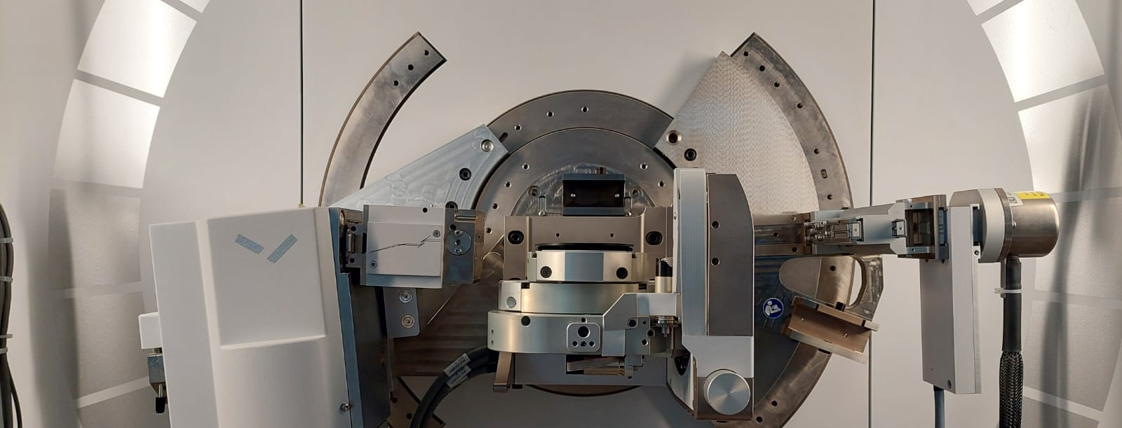
X-Ray Reflectometry
Malvern Panalytical Empyrian diffractometer setup
2θ
Hybrid monochromator
Specular reflection
Detector
Incident beam
θ_{i}
θ_{r}
X-ray source
θ
Sample

Slide 3
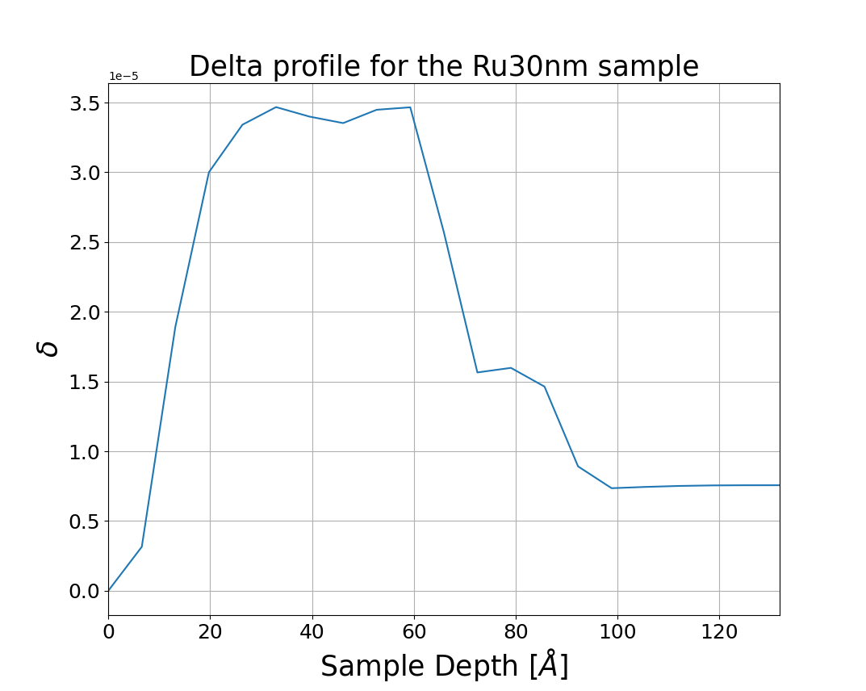
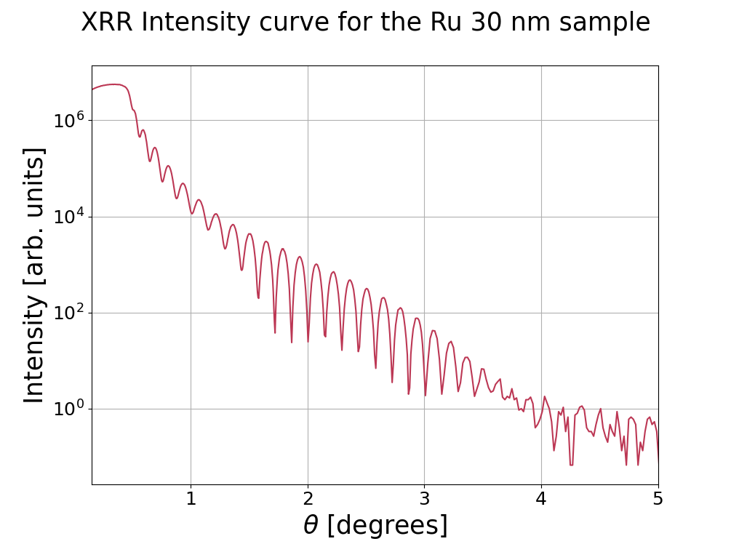
Analysis of XRR data→ solving inverse problem

Slide 4

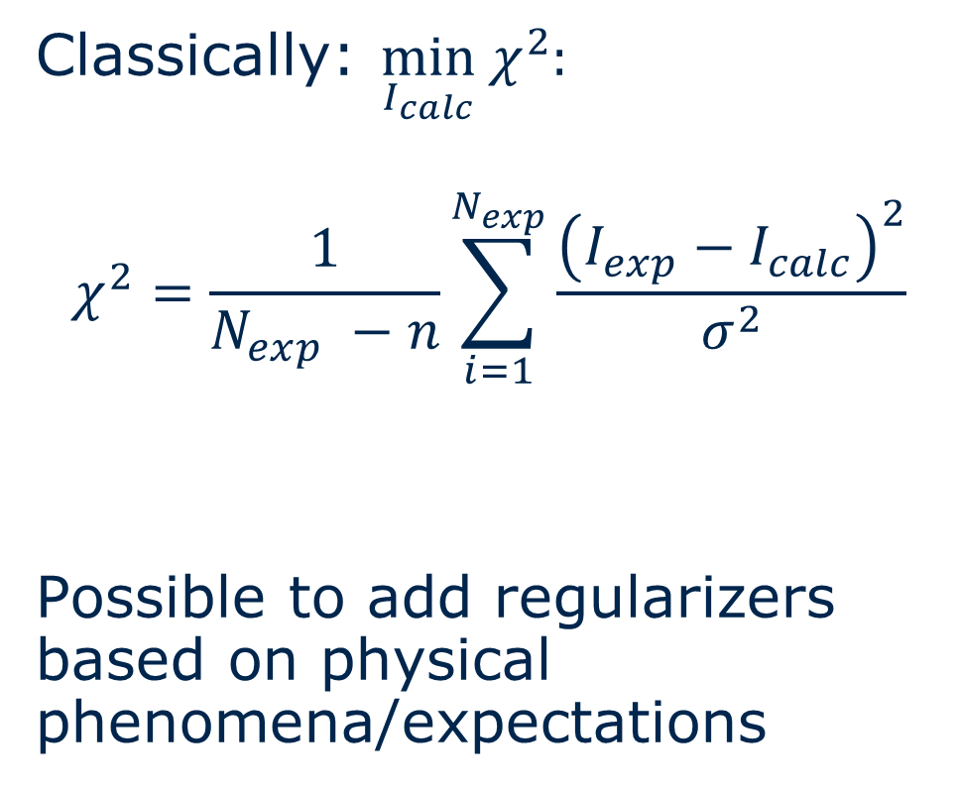
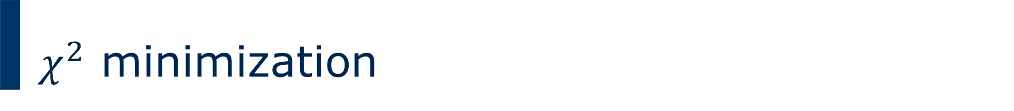
$χ^{2}$ minimization
Classically: $\min_{I_{calc}} χ^{2}:$
$$χ^{2}=\frac{1}{N_{exp} −n}\sum_{i=1}^{N_{exp}}{\frac{{\left(I_{exp}−I_{calc}\right)}^{2}}{σ^{2}}}$$
Possible to add regularizers based on physical phenomena/expectations
Note $χ^{2}\left(x+h\right)≈χ^{2}\left(x\right)+g_{s}^{T}h+\frac{1}{2}h^{T}H_{s}h$
Minimum: $g_{s}^{T}h$ = 0

Slide 5
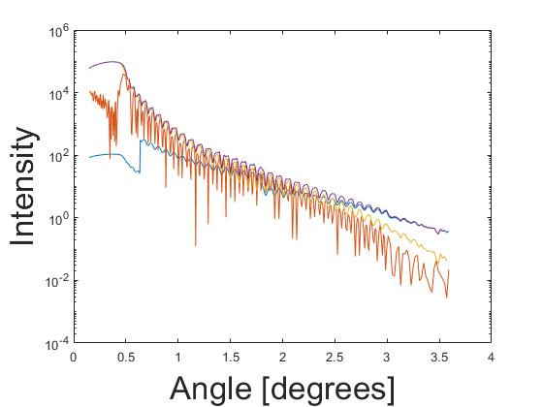
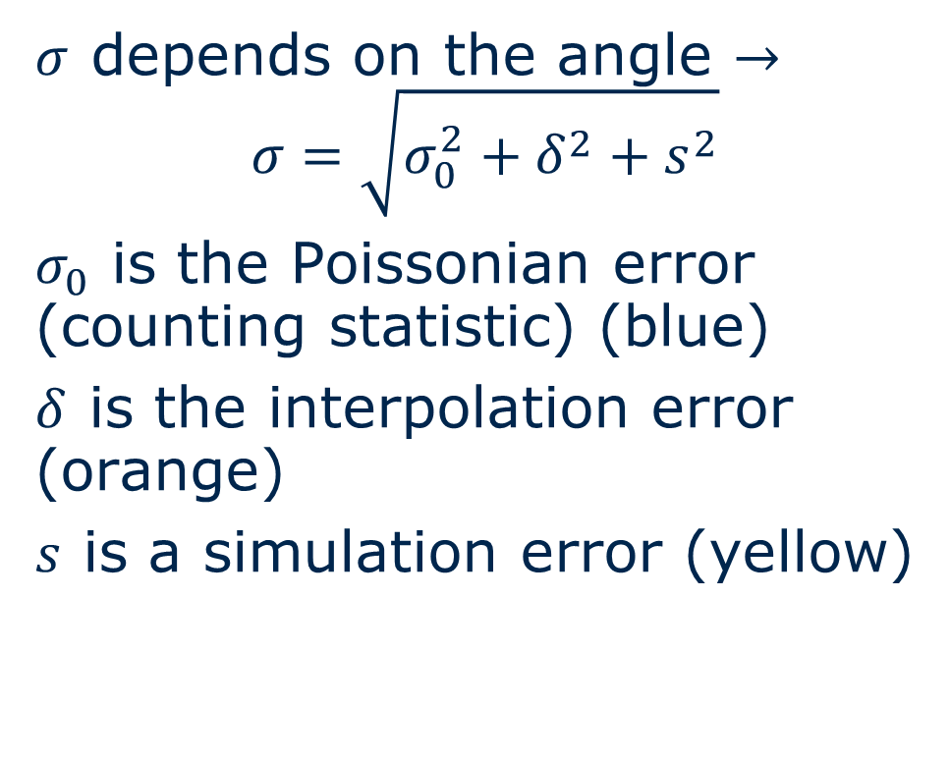


Account for measurement errors $σ^{2}$
Plot of $σ$ vs. $θ$
$σ$ depends on the angle $→$
$$σ=\sqrt{σ_{0}^{2}+δ^{2}+s^{2}}$$
$σ_{0}$ is the Poissonian error (counting statistic) (blue)
$δ$ is the interpolation error (orange)
$s$ is a simulation error (yellow)

Slide 6
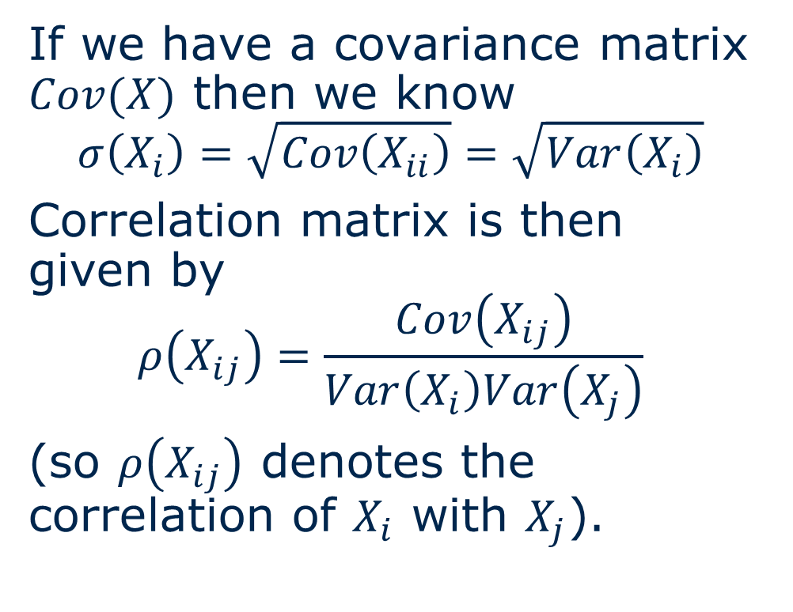
Correlation and Covariance
If we have a covariance matrix $Cov(X)$ then we know
$$σ\left(X_{i}\right)=\sqrt{Cov\left(X_{ii}\right)}=\sqrt{Var\left(X_{i}\right)}$$
Correlation matrix is then given by
$$ρ\left(X_{ij}\right)=\frac{Cov\left(X_{ij}\right)}{Var\left(X_{i}\right)Var\left(X_{j}\right)}$$
(so $ρ\left(X_{ij}\right)$ denotes the correlation of $X_{i}$ with $X_{j}$).
How to find this covariance matrix?
Notes:
+ tell about parameter space reduction by investigation of correlation matrix

Slide 7
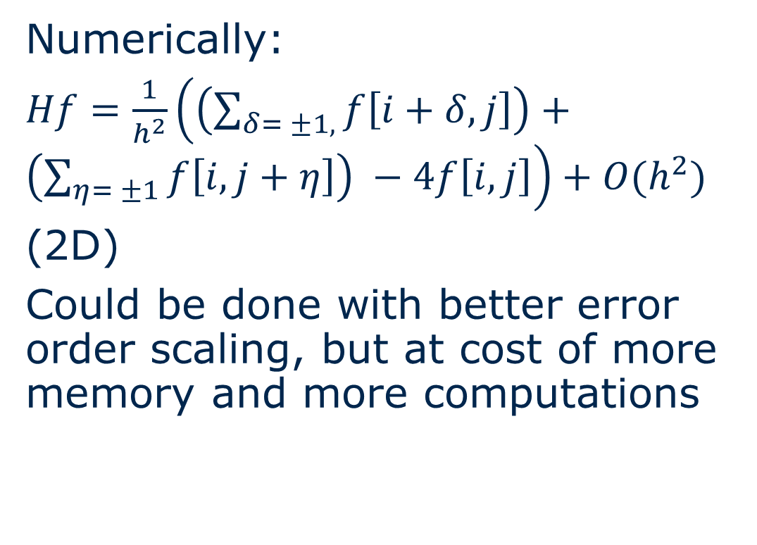
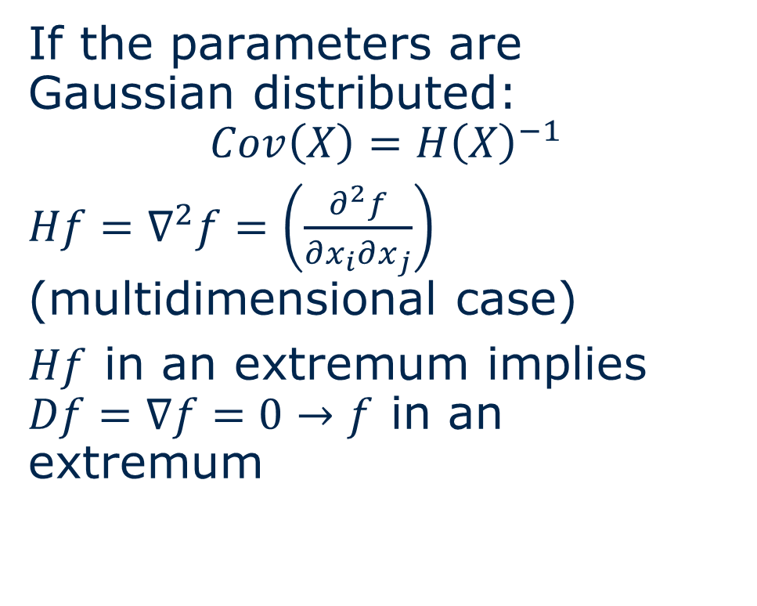
Hessian Approach
If the parameters are Gaussian distributed:
$$Cov\left(X\right)=H{\left(X\right)}^{−1}$$
$Hf=∇^{2}f=\left(\frac{∂^{2}f}{∂x_{i}∂x_{j}}\right)$ (multidimensional case)
$Hf$ in an extremum implies $Df=∇f=0→f$ in an extremum
Numerically:
$Hf=\frac{1}{h^{2}}\left(\left(\sum_{δ= ±1,}{f\left[i+δ, j\right]}\right)+\left(\sum_{η= ±1}{f\left[i, j+η\right]}\right) −4f\left[i,j\right]\right)+O(h^{2})$
(2D)
Could be done with better error order scaling, but at cost of more memory and more computations

Slide 8
Application (hands-on)
Install the following package:
github.com/dashee13/QUNOM2023

Slide 10
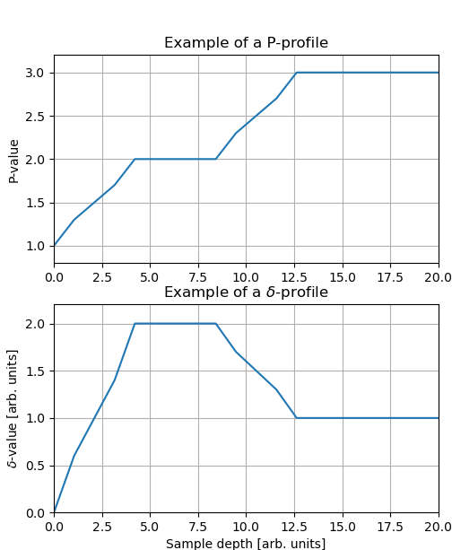
Appendix: Free-form (if interested)
d | Lamellas
I1 | 1 1.3 1.5 1.7 1.9
L1 | 2
I2 | 2.3 2.5 2.7 2.9
Subst. | 3

Slide 11

$$R\left(p\right)=λ\sum_{i=1}^{N−2}{{\left(−p_{i}+2 p_{i+1}−p_{i+2}\right)}^{2}}$$
(Free-form) (or e.g.${\left|\left|LI_{calc}\right|\right|}_{1}$)

